Slide 1
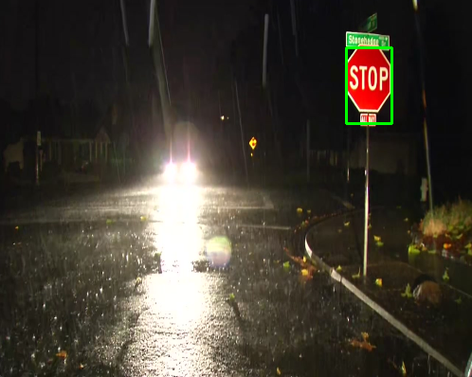

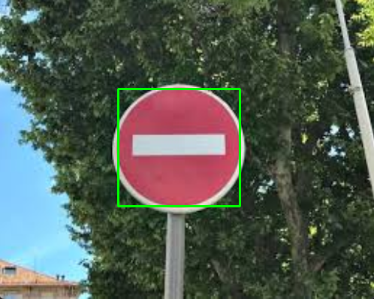
Road Sign Detection and Classification in diverse lightings
December 4th, 2023
Baraa' Bilbeisi

Slide 2


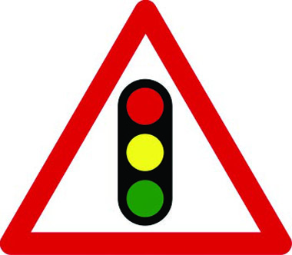

Objectives
To develop an image processing pipeline that can accurately detect and classify road signs from RGB images of various lighting conditions, such as poor contrast, overexposure, shadows, low resolution, and between similar color gradients.
To classify the road signs accurately to distinguish between the following signs:
  ‘Stop’
  ‘Yield’
  ‘Traffic jam’
  ‘Do Not Enter.’

Slide 3
Requirements
Contrast enhancement: Improve visibility in images that are in low or high light.
Filtering: Reduce noise and enhance features.
Edge/Boundary/Corner Detection: Find and draw edges of road signs
Feature Extraction: Extract redness of road signs for classification.
Classification: Machine Learning Classification.
  Categorize road signs based on features extraction

Slide 4

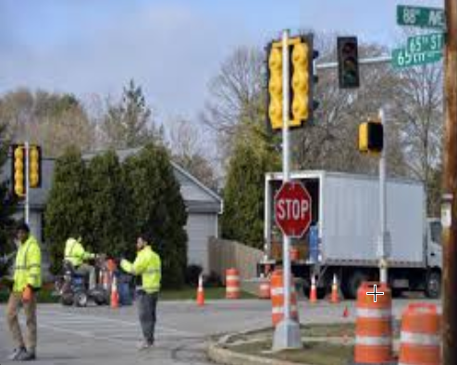
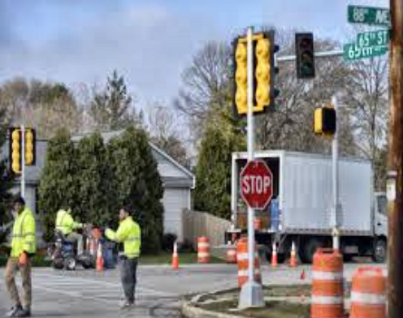
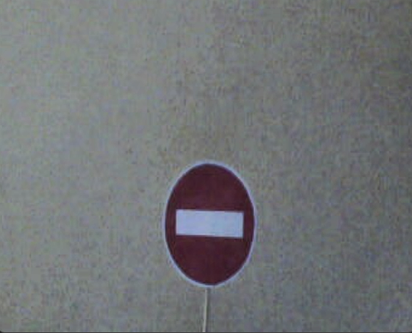
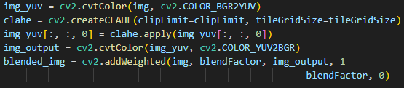
Contrast enhancement: CLAHE Histogram
Equalization
Convert to YUV color space.
Apply CLAHE to Y channel.
Convert back to BGR color space.
Blend with the original image.

Slide 5
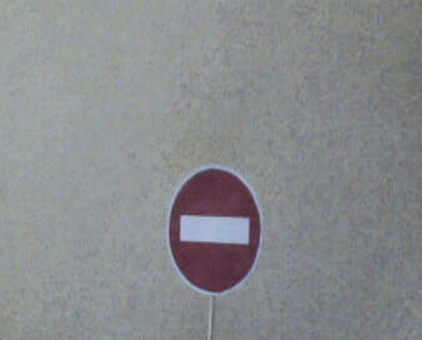
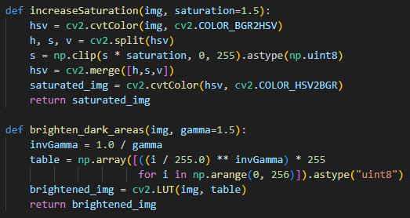
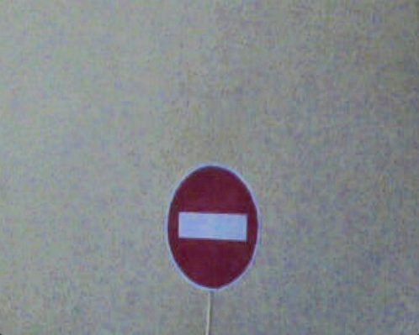
Shadow and Saturation Enhancements (extra)
Convert to HSV color space.
Split HSV channels
Multiple S channel
Calculate inverse Gamm
Apply gamma correction to all pixels (lower more relative than higher pixels)

Slide 6


Filtering Images with Median Blur
Apply Median Blur for noise removal.

Slide 7

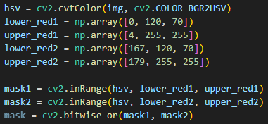

Feature Extraction - Emphasizing Redness
Convert to HSV color space
Manipulate the color space of lower/higher reds
Define and apply masks for red color

Slide 8
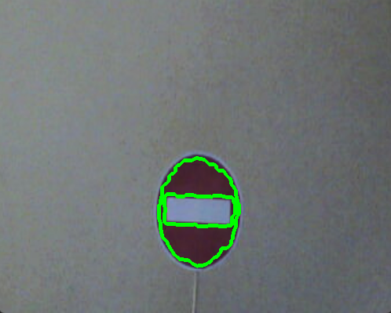
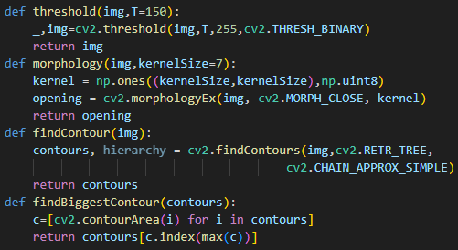
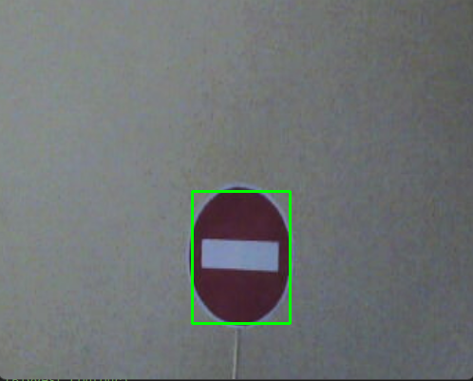
Binary Object Detection and Contour Finding
Apply binary thresholding to segment the image.
Use morphological operations to enhance image structures.
Find and extract contours for object detection.

Slide 9
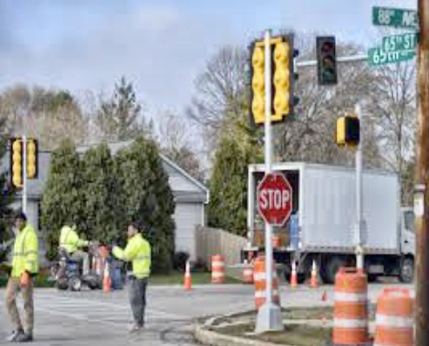
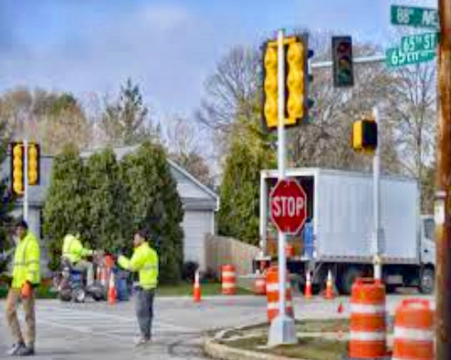
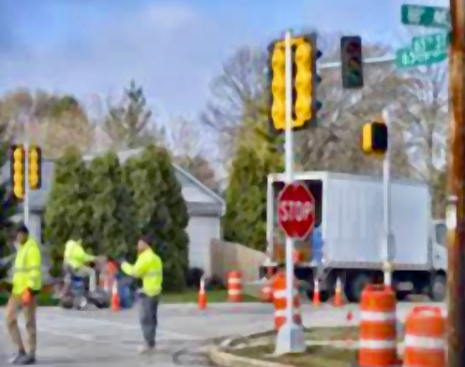
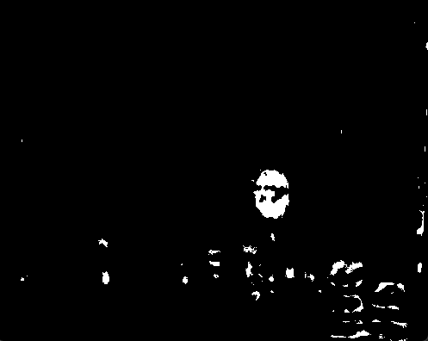
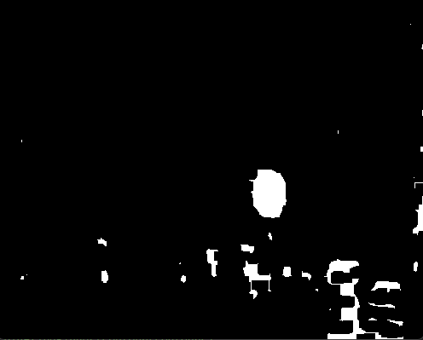
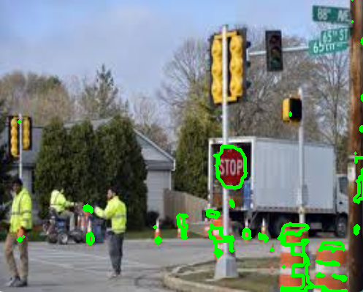
Another Example

